Slide 1

Income Source & Income Change Indicator
RAM-N – rCARI Team

Slide 2

Background
Why a new indicator for economic vulnerability?

Slide 3
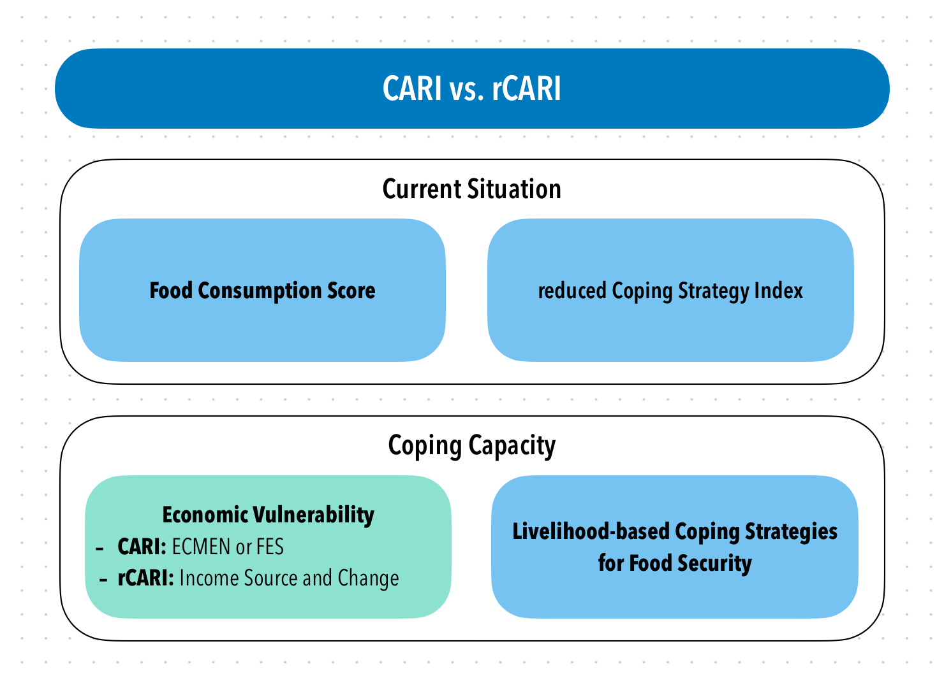
Background
CARI & rCARI (remote CARI) aggregate AFI indicators in a similar way
Differs in the Economic Vulnerability indicators
Notes:
Consolidate Approach for Reporting food Insecurity (CARI)
rCARI useful in emergencies where F2F survey is not feasible
rCARI though easily available, results are not globally accepted because methodology is not been empirically validated against other standard methods- CARI
rCARI is based on the following modules
Food consumption score
Consumption-based coping strategy (rCSI)
Livelihood coping strategy (usually a shorter version of the original)
Income sources & income changes

Slide 4
Background
Challenge with Expenditure data
Time consuming/effort
Data quality concerns
Difficult/absence of standard module for Remote Interviews
Onset of Covid-19 & need for food security analysis
WFP developed the income choice & income change indicator
Proxy for Economic vulnerability
Current coping capacity – CARI (rCARI)

Slide 5
The income indicator
The full name is “INCOME SOURCE & INCOME CHANGE INDICATOR”
A matrix of 3 levels of questions (covering the last 12 months)
Main occupation of the HHH or respondent
Main source of income
Income change in the last

Slide 6
The income MODULE
Variable | Questions in Income Module | Choice List
HHHOccupation | What is the occupation of the household head? | Open Ended
HHInc_PCT | How many household members are contributing to the household income? | Number
HHIncFirst | Main source of income for the household.](Hint: This is the most stable income source for the household)Relevance: HHIncNb > 0 | 1 Wage Labor – Professional 2 Wage Labor – Skilled 3 Wage Labor - Unskilled/Casual/Agriculture 4 Wage Labor - Unskilled/Casual/non-agriculture 5 Pension 6 Remittances 7 Aid/gifts 8 Borrowing money/Living off debt 9 High risk activity (e.g. begging, scavenging) 10 Saving/selling assets 11 Petty trade/selling on streets 12 Small trade (own business) 13 Medium/large trade (own business) 14 Small Agriculture production including livestock (own land/livestock) 15 Medium/large agriculture production including livestock (own land/livestock) 999 Other (specify)
HHIncFirst_Oth | SpecifyRelevance: HHIncFirst_SRi = ‘999’
HHIncChg | Was there a change in income over the last year? (Please do not take into account the currency devaluation.) | 0 No change 1 Increased 2 Reduced by less than 25% 3 Reduced by more than 25% and less than 50% 4 Reduced by more than 50%

Slide 7
The income indicator
Classification of Income Sources
Regular employment/income
Wage Labor – Professional/skilled
Pension
Small/Medium/large trade (own business)
Small/Medium/Large agriculture production including livestock (own or rented land/owned livestock)
Irregular employment/income
Wage Labor - Unskilled/casual/agriculture/unskilled/casual/non-agriculture
Remittances
Petty trade/selling on streets
No income
Aid/gifts
Borrowing money/Living off debt
High risk activity (e.g. begging, scavenging)
Saving/selling assets
No income source
Notes:
rCARI is based on the following modules
Food consumption score
Consumption-based coping strategy (rCSI)
Livelihood coping strategy (usually a shorter version of the original)
Income sources
Changes in income

Slide 8
The income indicator
Categorization of Income Change
No Change
The income has flow from the main source has not changed in the last
Increased
Respondent’s main income has increased in the period
Reduced less than 25%
Main income source reduced but the overall impact is less than 25%
Decreased between 25% & 50%
The decrease is more up to half of the income
Decreased > 50%
More than half of the income is lost
Notes:
rCARI is based on the following modules
Food consumption score
Consumption-based coping strategy (rCSI)
Livelihood coping strategy (usually a shorter version of the original)
Income sources
Changes in income

Slide 9
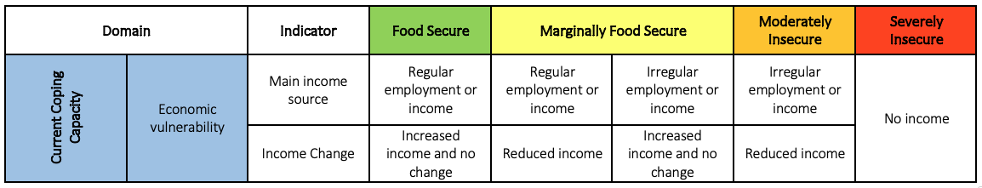
The income indicator

Slide 10
The income indicator
Domain |  | Indicator | Food Secure | Marginally Food Secure |  | Moderately Insecure | Severely Insecure
Current Coping Capacity | Economic vulnerability | Main income source | Regular employment or income | Regular employment or income | Irregular employment or income | Irregular employment or income | No income
 |  | Income Change | Increased income and no change | Reduced income | Increased income and no change | Reduced income

Slide 11
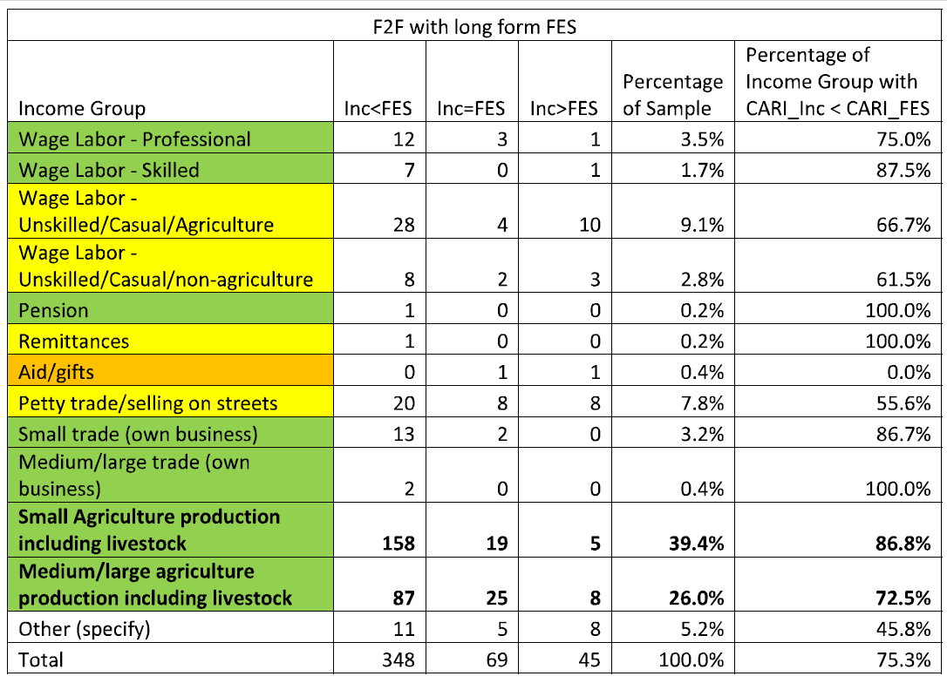
The income vs. FES

Slide 12
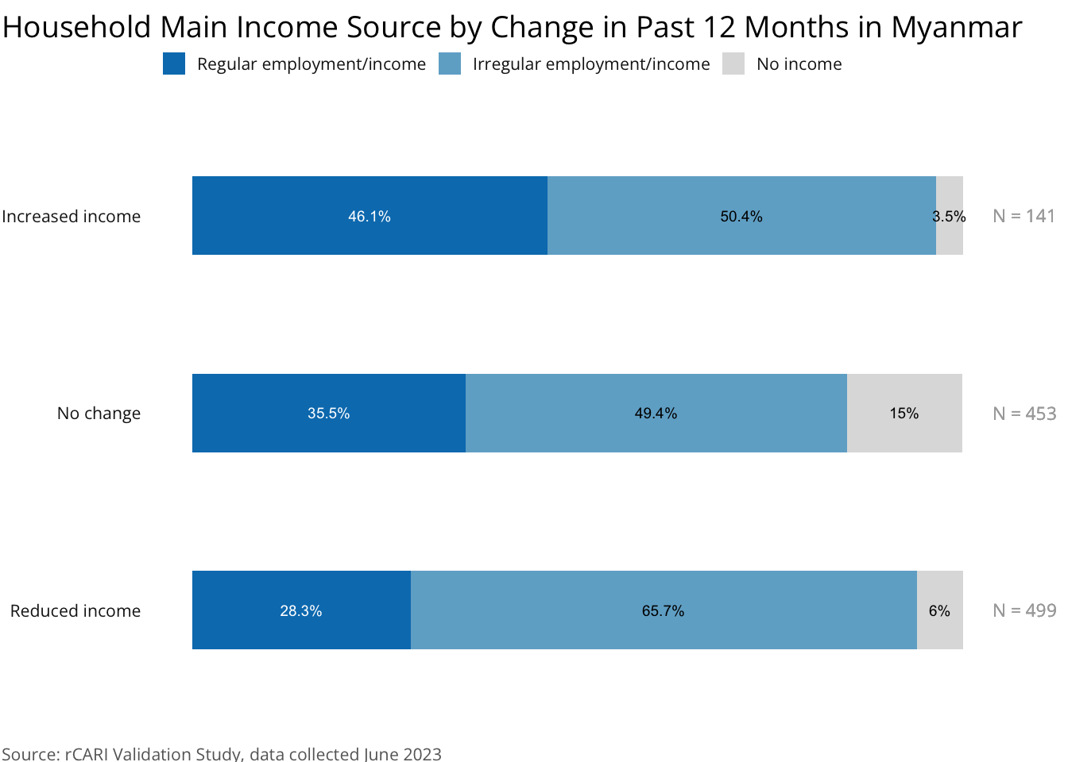
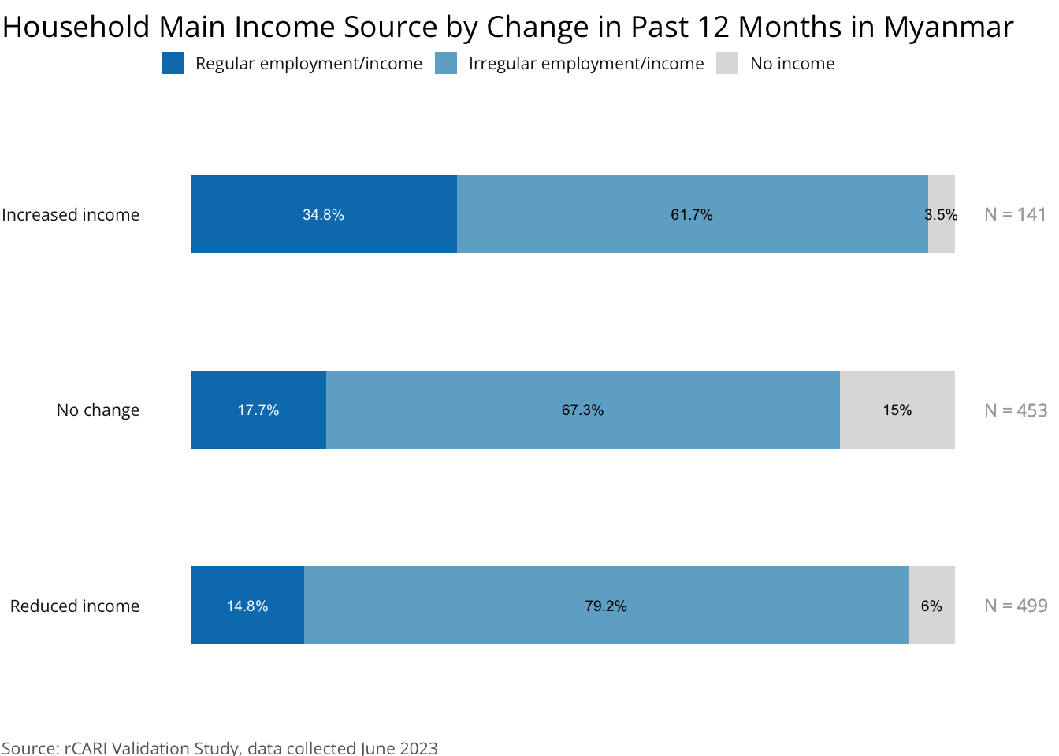
Before vs. After Recategorization - Myanmar
Before
After

Slide 13
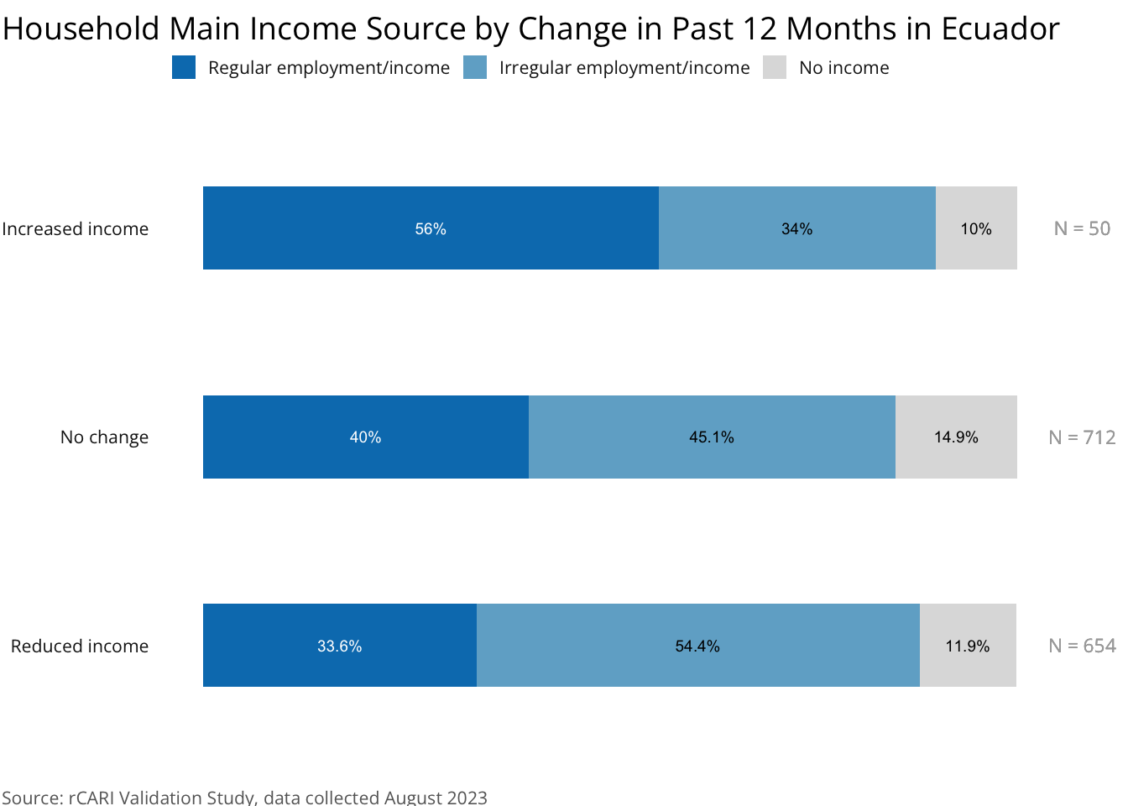
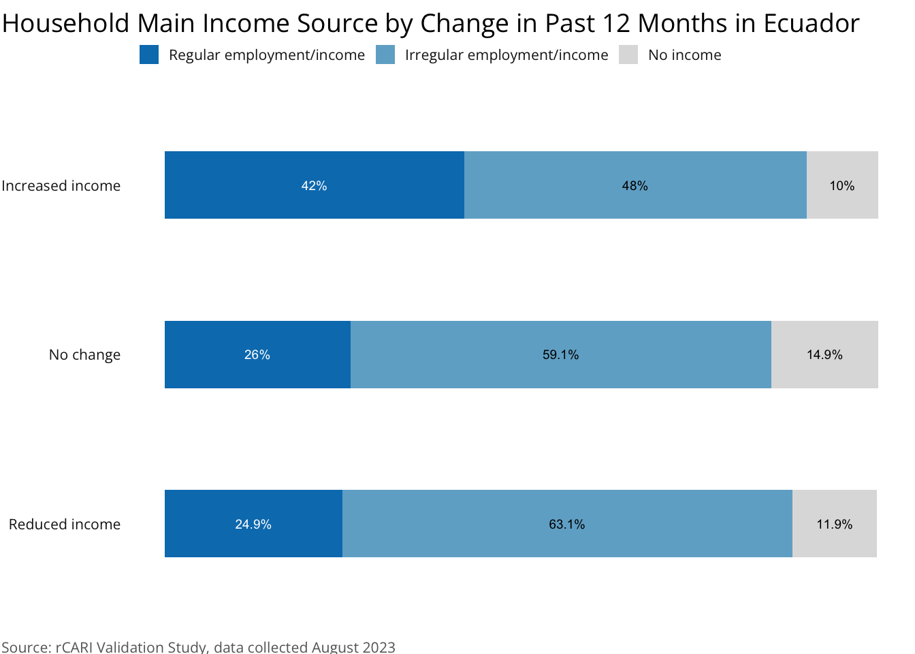
Before vs. After Recategorization - Ecuador
Before
After

Slide 14
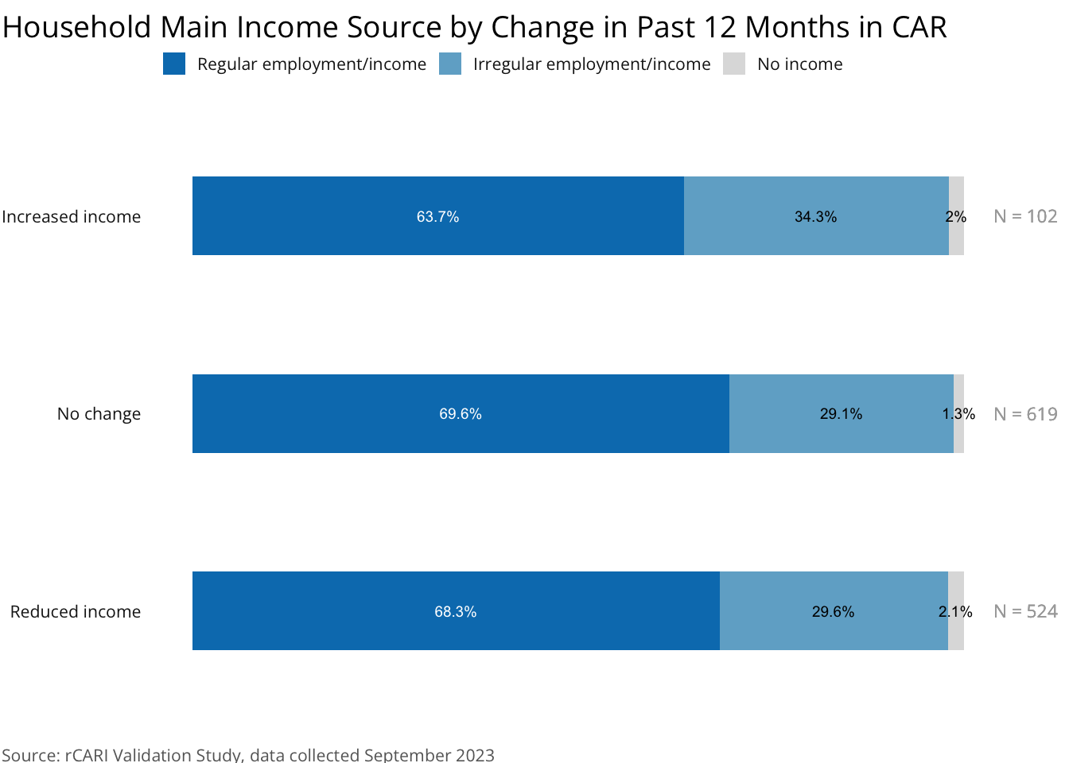
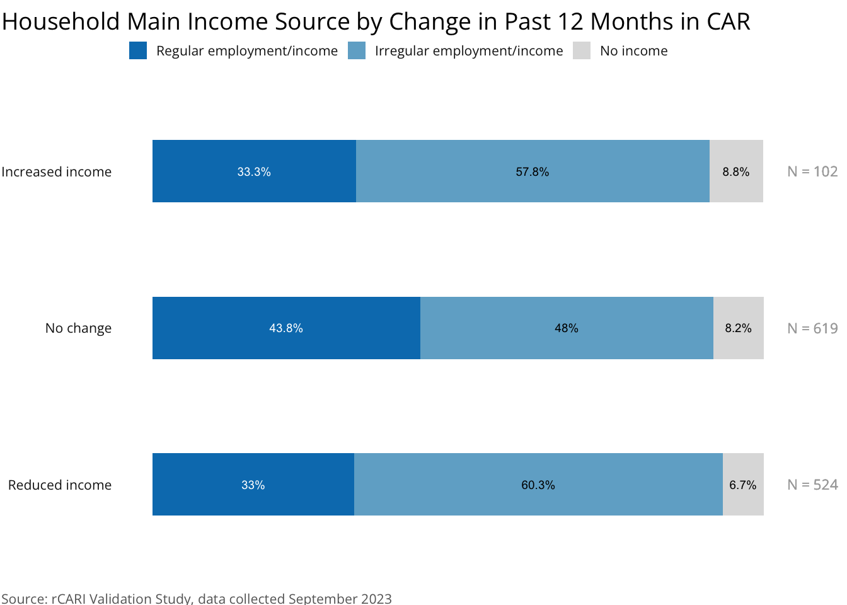
Before vs. After Recategorization - CAR
Before
After

Slide 15
Next steps…
1
Expand the testing to additional available dataset
Possible reclassification of the income types based on the standardized income categorization
Sensitivity analysis of the individual income sources [HHIncFirst]
Expand the study to more countries
2
3
4

Slide 16
Questions/Comments…

Slide 18
Updates on research components
APP-FA – rCARI Study Team

Slide 19
The Technical Advisory Board
The Technical Advisory Board is made of 5 Professionals Across Academia, IPC, FSIN, BHA, and WFP
Prof. Maxwell Daniel (Tufts University, USA)
Prof. Sebastian Vollmer (University of Gottingen, Germany)
Korpi Kaija (IPC)
Federica Carfagna (FSIN)
Michael Schenkmann (BHA)
Sidd Krishnaswamy (WFP)
1
2
3
4
5
6

Slide 20
IPC vs CARI study
a. APP-FA started this component
Data preparation
Initial analysis and presentation
Data aggregation
b. Transferred to an independent consultant - Prof. Diego Rose (Tulane University, U.S.A)
Supported by the APP-FA Team
c. Initial analysis of complete
Results yet to be shared with the TAB
Qualitative interviews with stakeholders currently ongoing

Slide 21
The rCARI validation & IPC/CARI compatibility studies
APP-FA – rCARI Study Team

Slide 22
Objective
Primary:
Validate the remote Consolidated Approach for Reporting Indicators of Food Insecurity (rCARI) – Using a survey experiment with stratified sample
Secondary
Validate income choice and income change indicator
Test and validate different expenditure modules (shorter versions)
Notes:
rCARI useful in emergencies where F2F survey is not feasible
The Challenge with rCARI numbers & methodology is that not it is been validated against CARI or IPC
Though is easily available, results are not globally accepted
rCARI is based on the following modules
Food consumption score
Consumption-based coping strategy (rCSI)
Livelihood coping strategy (usually a shorter version of the original)
Income sources
Changes in income

Slide 23
Pilot Countries
Global representation (In at least 4 RBx)
Relevance of rCARI
Mobile network penetration
West Africa [RBD] Burkina Faso & Central African Republic
Panama [RBP] Ecuador & Guatemala
Middle East [RBC] Iraq?? (Access is only limited to camps (refugees and IDPs))
Southeast Asia [RBB] Myanmar

Slide 24
Study organogram…
APP-FA
rCARI Team
Head of VAM RBx
Facilitates communication with COs & supporting training
Head VAM
COs
Supports in identifying the study areas together with the APP-FA team
Supports with admin work for training
Budgeting and logistics
Provides technical support for COs
Leads in field work (implementation)
Data analysis and report writing
Designs the study methodology

Slide 25
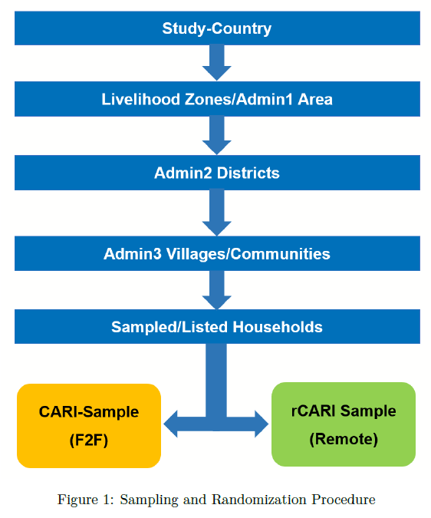
The survey experiment…

Slide 26
Work done…
Conducted two training of trainers’ (ToT) workshops in for RBP & RBD
3 pilots completed so far
Myanmar
Ecuador
CAR –Two separate analysis produced
BKF – yet to be analysed
3 Reports produced and presented to BHA (Draft reports)

Slide 27
Work completed and Workplan
Status Activity | Completed | Completed | Completed | Completed | In-progress | In preparation phases
Pilot testing
Myanmar
Ecuador
CAR
Burkina Faso
Iraq
Guatemala
Mauritania
Data Analysis |  |  |  |  |  | On going
Report writing |  |  |  |  |  | On going

Slide 28
Tentative work for remaining pilot
Time Countries | Nov 2024 | Dec 2024 | Jan 2025 | Feb 2025 | Mar 2025 | Apr 2025 | May 2025 | Jun 2025 | Jul-Aug 2025
(1) Iraq | Planning | Data collection
(2) Mauritania |  |  | Planning | Data Collection
(3) Guatemala |  |  |  | Planning | Data Collection
(4) Burkina Faso | Data Analysis Ongoing
Data Analysis
Report writing
Note: There would be intermittent presentation to the TAB and BHA after each pilot country

Slide 29

Questions

